Slide 1
Locations to Open Two New Chain Restaurants
Rong Ma

Slide 2
Instruduction
Restraunt: “Sunney Lantern”
City: Coventry, RI
Interest: Stakeholder
Two more cities in Rhode Island

Slide 3
Data Source
Coventry: 41.68, -71.66
Coordinate for all cities in Rhode Island
Foursquare explor neighborhood

Slide 4
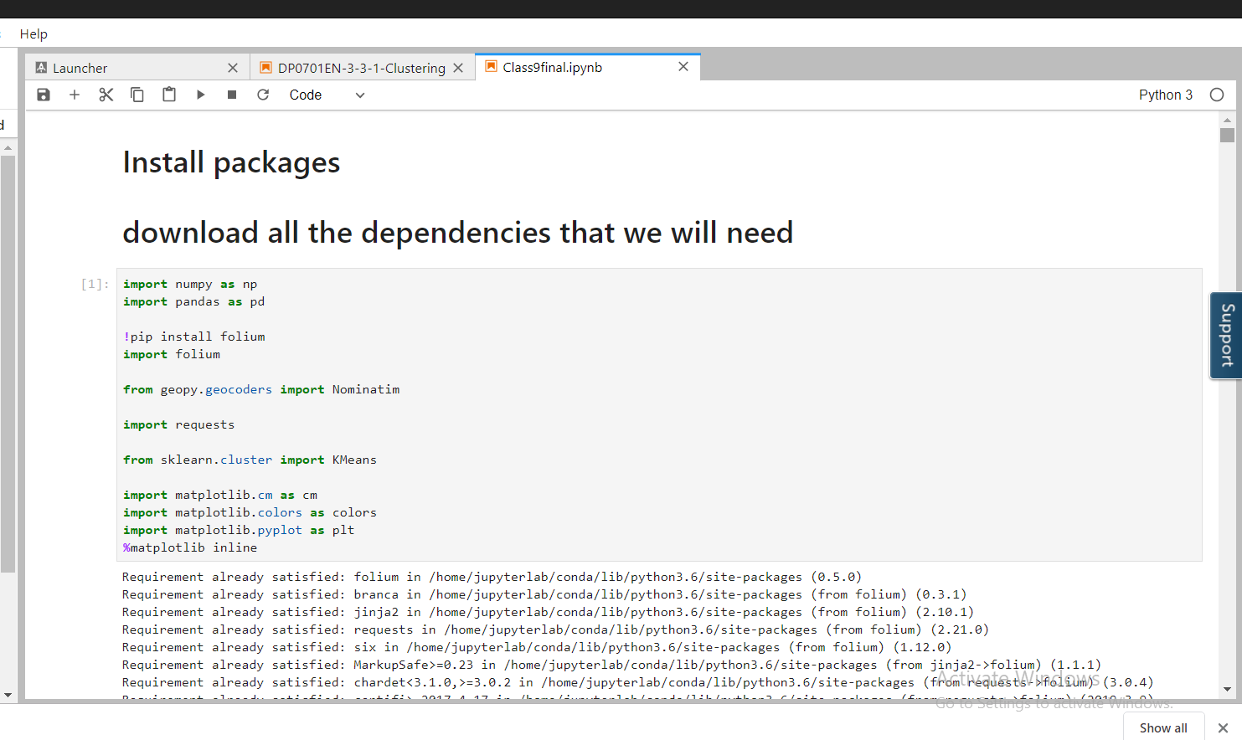
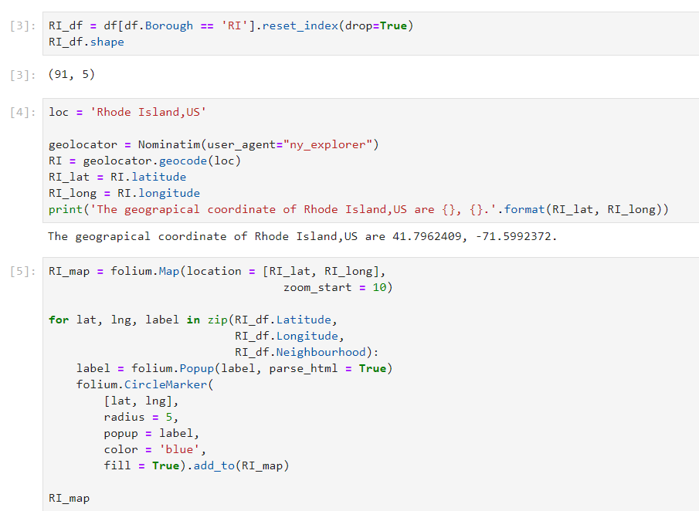
Methodology
Download packages
Data Cleaning
Map of Rhode Island

Slide 5
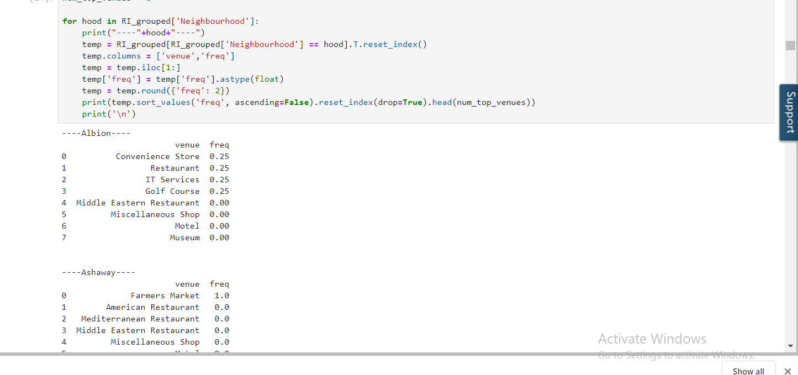
Methodology
Obtain the neighborhood information
K-cluster
Map cluster

Slide 6
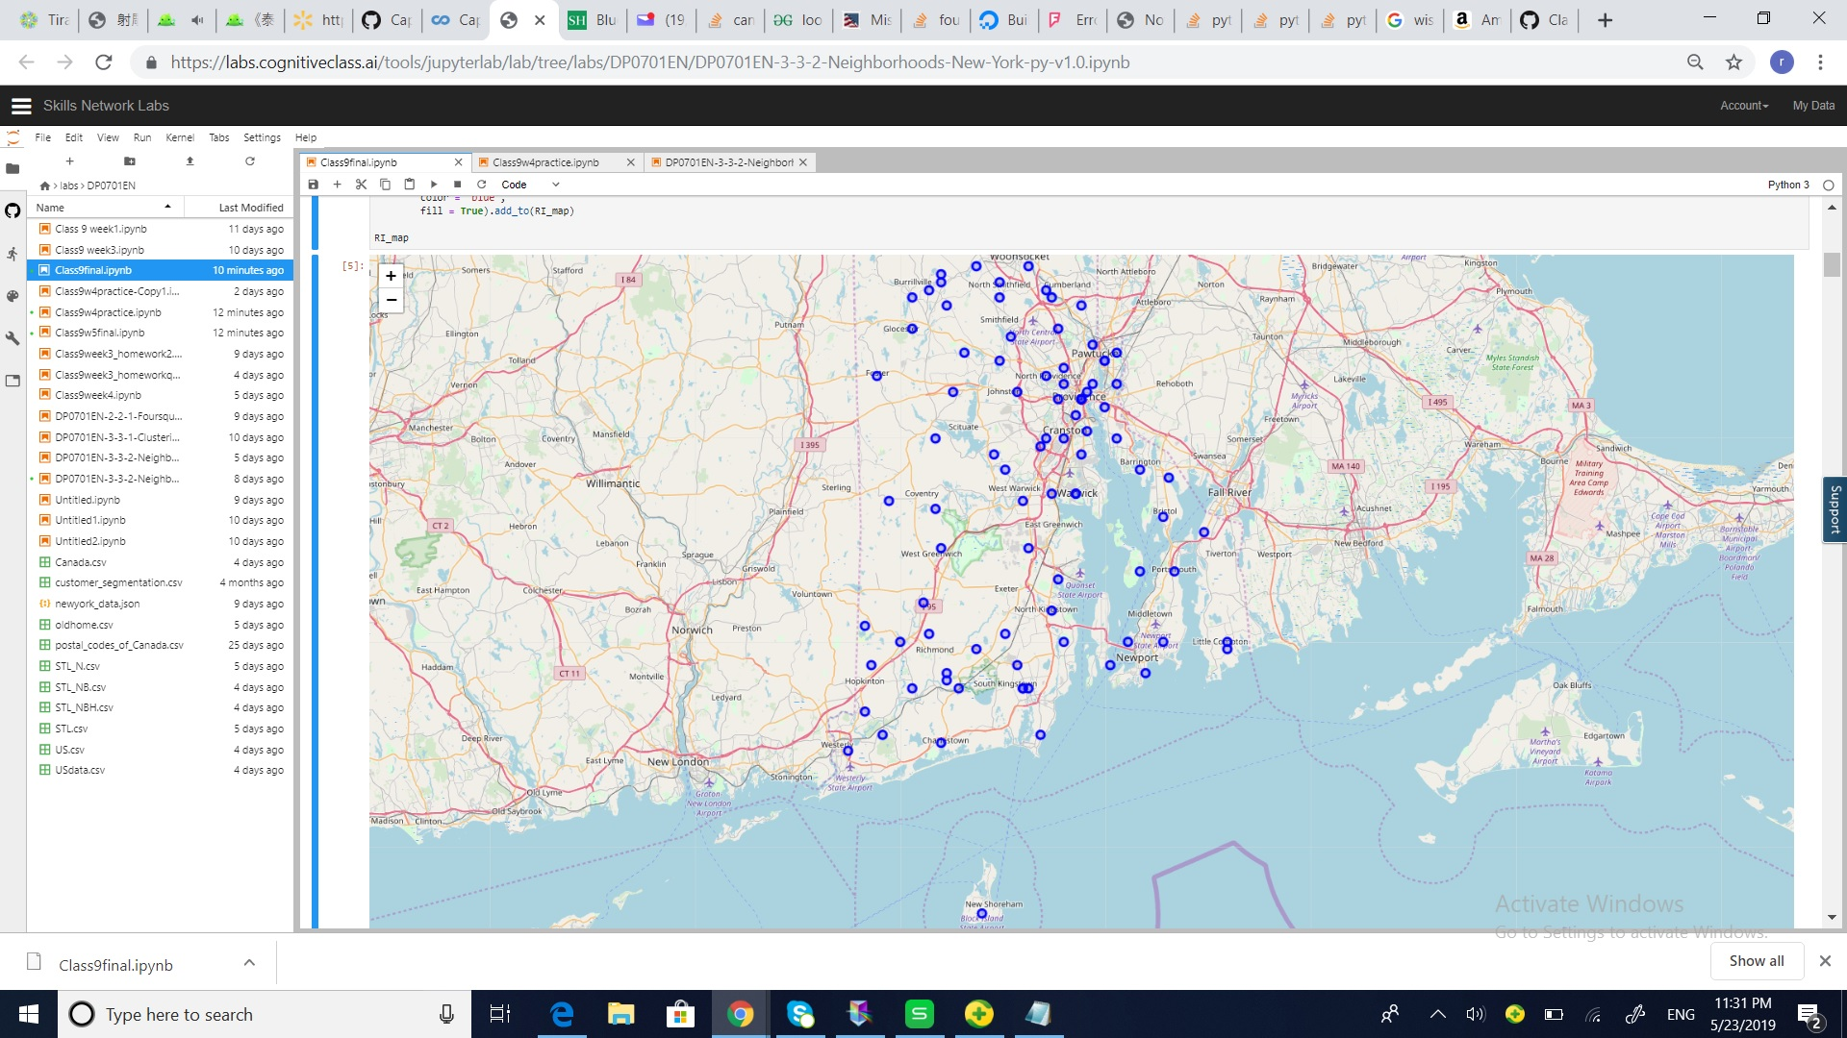
Result
Neighborhood were mapped to the state of Rhode Island

Slide 7
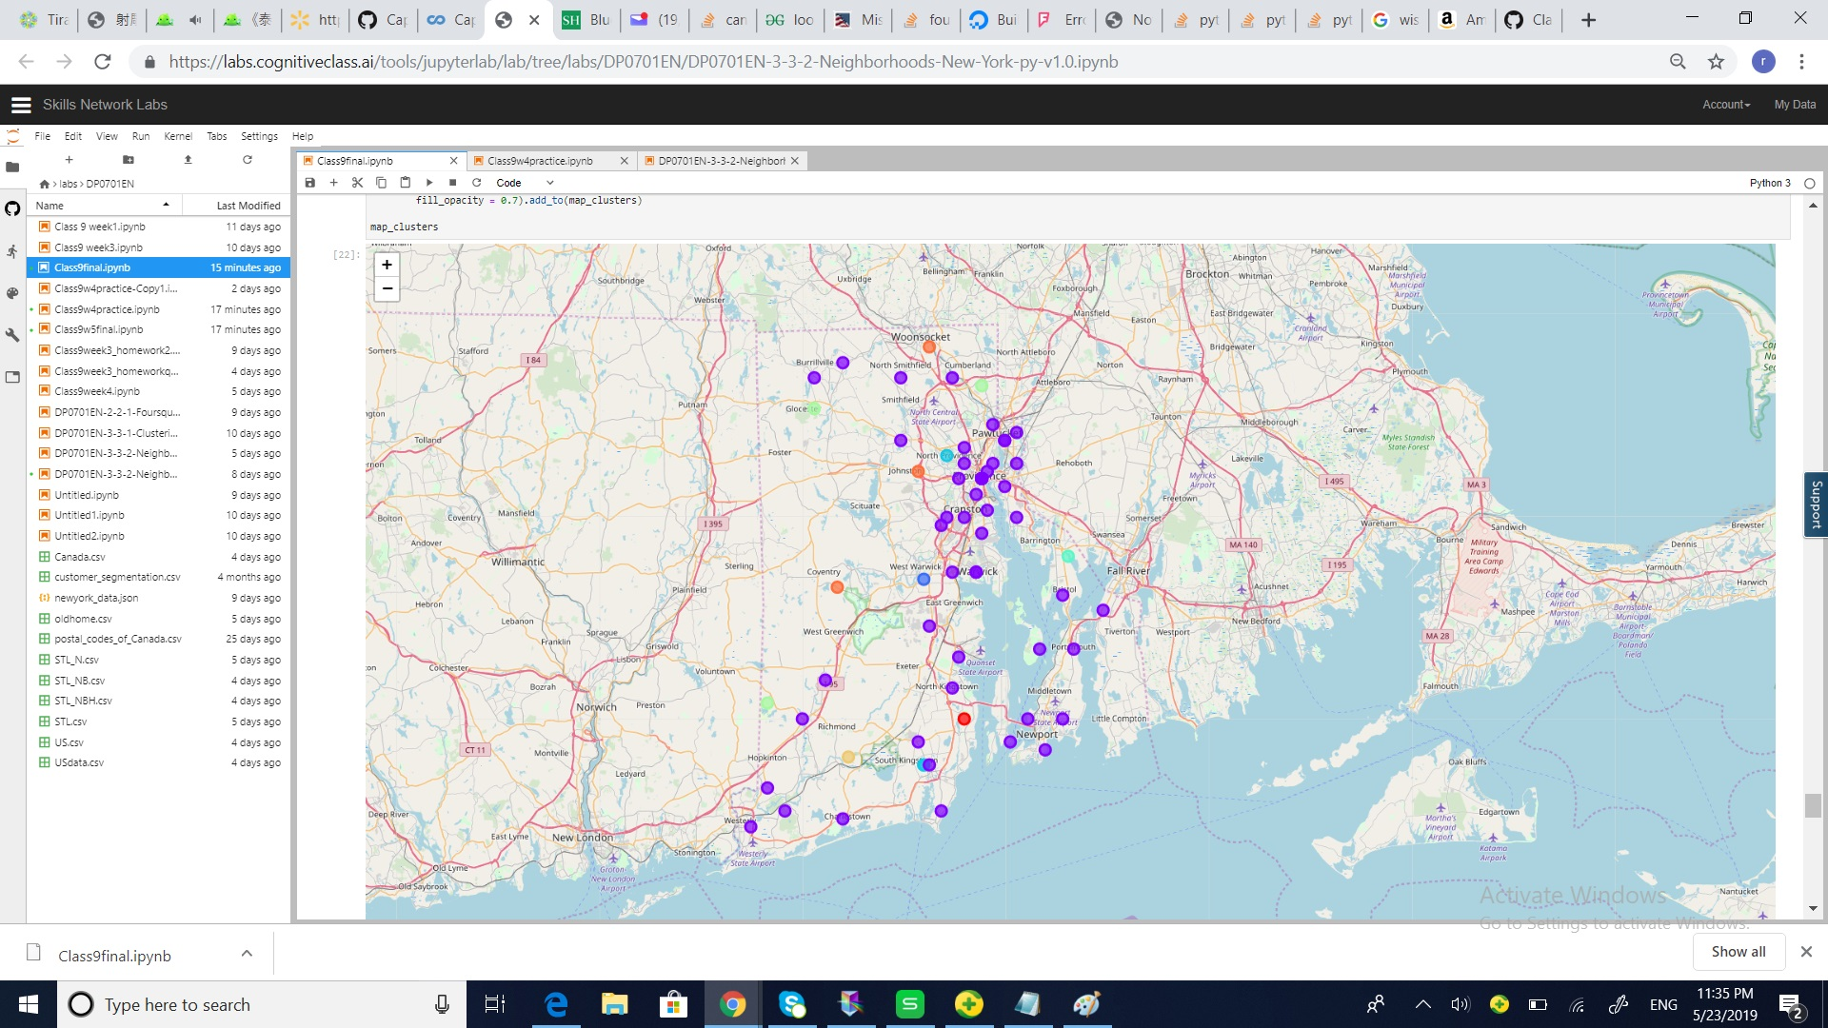
Result
Rhode Island were laeled with cluster labels

Slide 8
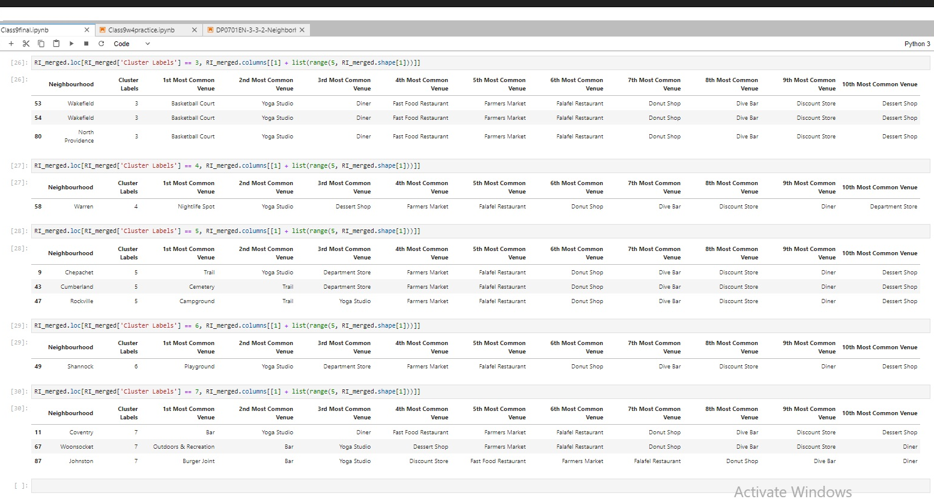
Result
Clusters of cities in RI

Slide 9
Discussion and Conclusion
The two cities fall in the same cluster as Coventry are Woonsocket and Johnston
These two cities are recommodated to stakeholders of “Sunny Lantern” for the locations to open new chain restraunt

